Slide 1
TUGAS DATABASE ORDER BY
DIMAS ABDI NUGROHO

Slide 2
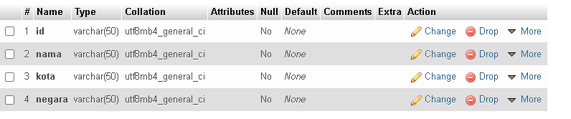
STRUKTUR TABEL

Slide 3
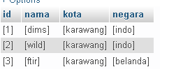
dATA

Slide 4

PERINTAH SQL

Slide 5

hasil

